Slide 1



Data Quality Check (DQC)
for the Integrated TB Information System (ITIS)

Slide 2
Background
LGUs are conducting DQCs for paper-based reports (usually quarterly)
Process of DQC includes checking for completeness, accuracy, consistency and timeliness of data
ITIS currently being used and LGUs able to generate quarterly reports
Data validation for ITIS includes checking of encoded data done at facility level. This should be done by the head of the DOTS/PMDT facility

Slide 3
Objectives
To validate NTP reports for the (insert period being reviewed, including cohort)
To identify issues in data quality in terms of completeness, accuracy, consistency and timeliness
To compute core NTP indicators per LGU (municipality/City)
Notes:
DQC is conducted ideally every quarter or at least once a year (to validate annual data).
Although availability and timeliness of data are also attributes of data quality, these two are best assessed under actual field conditions or during monitoring visits. For DQC conducted as a workshop, only three attributes will be assessed– completeness, accuracy and consistency.

Slide 4
Proposed Program
Time | Duration | Activity
DAY 1
8-10 am | 2 hours | Checking completeness Encoding of missing data
10 am-12 pm | 2 hours | Checking accuracy of data
1-4 pm | 3 hours | Checking consistency of reports
4-5 pm | 1 hour | Checking timeliness
DAY 2
8 am-12 nn | 4 hours | Determining and analyzing NTP indicators Analysis per LGU/DOTS facility Review of plans against performance Agreements on next steps
1-5 pm | 4 hours | For PHO/CHO Consolidation of LGU reports Analysis of NTP indicators Review of plans against performance

Slide 5
DQC Procedures
COMPLETENESS OF DATA

Slide 6
Records and Reports Required
Paper-based records
  TB Register (Form 6a) – 2018 and 2017 (1Q)
  NTP Laboratory Register for Microscopy and Xpert MTB/RIF (Form 3)
  Treatment Cards(Form 4) of patients registered for 1Q 2018 and 1Q 2017
  Presumptive TB Masterlist (Form 1)
ITIS
  Laptop
  Internet access
  For offline version: latest dispatch file
Notes:
The invitation and coordination with participants should emphasize what records and reports to bring.
At the start of the workshop, check the records and reports brought by the participants. The list above will guide you in doing this.
The last item (stock inventory for Cat 1, Cat 2 and children) is not from any NTP records but can be obtained from the stock-cards. This can also be obtained by physical count to be done prior to the workshop.

Slide 7
Step 1: Get a partner RHU
DOTS facilities will be grouped by 2s.
Give the paper-based records to your partner DOTS facility
Your partner RHU will do data quality check on your records/reports
Notes:
Explain that a third party should be the one to validate and assess the data. Hence, each facility should have a partner.
Emphasize to the participants the importance of taking extra care of records entrusted to them by their partner facility.
Note: Only records will be exchanged. The reports should be held by the owner facility since this will be validated later on.
At this point, give each participant a copy of the DQC Forms to be used during the exercises.

Slide 8
Stop here until all RHUs have identified a partner and given their records…

Slide 9
Checking for Completeness
Involves two major steps:
  Compare total number of patients from the DSTB register with the total patient count generated from ITIS (patient list) --- checks completeness of patients encoded
  Generate list of all encoded cases and identify missing data fields – checks completeness of individual patient data

Slide 11


Checking at the Facility Level
1. Check completeness
2. Generate the specific ITIS report needed (eg. report 3a). Compare the Total Cases if tally with the recorded cases in the TB Register.
In the ITIS report, click the total cases to generate a patient list. Sort the ‘case #’ header. Compare with TB register. Check for discrepancies.
2A If with discrepancies:
2A.1 Encode the missing cases; Update cases with incomplete data. Validate the encoded / updated cases.
2A.2 Generate again the same ITIS report, this time, check the figures per table (eg. report 3A Table 1) per column by comparing with the recorded cases.
If with discrepancies:
Repeat Steps 2A.1 and 2A.2

Slide 12
161080034
Count the number of patients registered
for the period being checked. Count two
periods, both the current quarter
and the same quarter 1 year ago,
for the cohort report.
Notes:
This is the DS-TB Register. Check for completeness just as in the Presumptive TB masterlist and Laboratory Register.
Each patient is considered one unit.
The number of patients to be checked will depend on the patient load for the quarter and the time available. If it is a quarterly DQC and there is enough time, all patients should be reviewed.
If time is limited, agree with the PHO on the maximum number of patients to be assessed. For example, 10 patients to be reviewed for completeness.

Slide 13
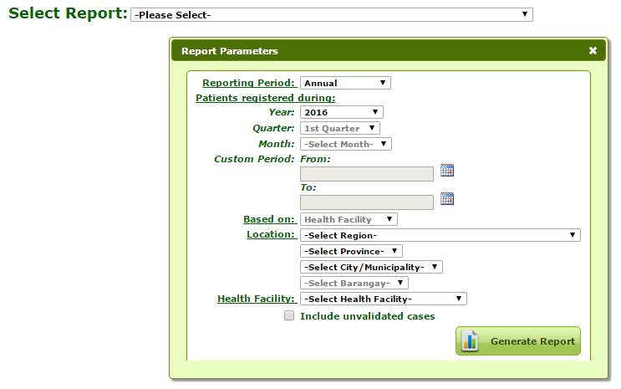
Checking at the Facility Level
Generate the specific report needed from ITIS (e.g., Report 3a).
Do this for both the current quarter
and the same quarter 1 year ago.

Slide 14
Checking at the Facility Level
The total cases registered should be the same as the manual count in the DSTB register.
28

Slide 15
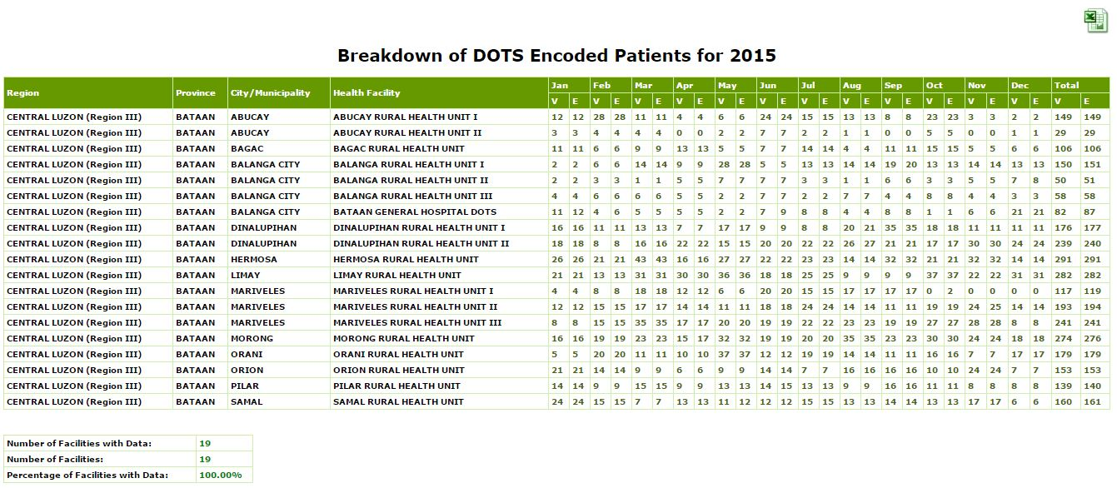
If number of ITIS cases is lower than the DSTB register count, generate the “per facility report” and check columns on “encoded” vs. “validated”
Encoded vs. Validated
Notes:
Possible causes of ITIS under-recording:
One possible cause is that validation of encoded data has not yet been done. To check this, generate the “per facility report” and check columns on “encoded” vs. “validated”. If there are more validated cases and they tally with the manual count, go back to the case records that have not yet been validated and click the validate function.
Another possible cause is that there are cases which have not been encoded. This will be seen in the “per facility report” above wherein both “encoded” and “validated” cases will be less than the manual count. To check this, click the total number of cases in the generated report to display the patient list and sort patient list by TB case number. Identify which TB case number is missing or not yet encoded. Encode the missing cases.

Slide 16
If number of ITIS cases is higher than the DSTB register count, check for double entries/encoding by generating the patient list and noting if there are double entries.
In the generated report, click the total number cases to display the patient list
‘Click to display patient list’
Notes:
If there are double entries, ask the KMITS representative for assistance in deleting the duplicate case.

Slide 17
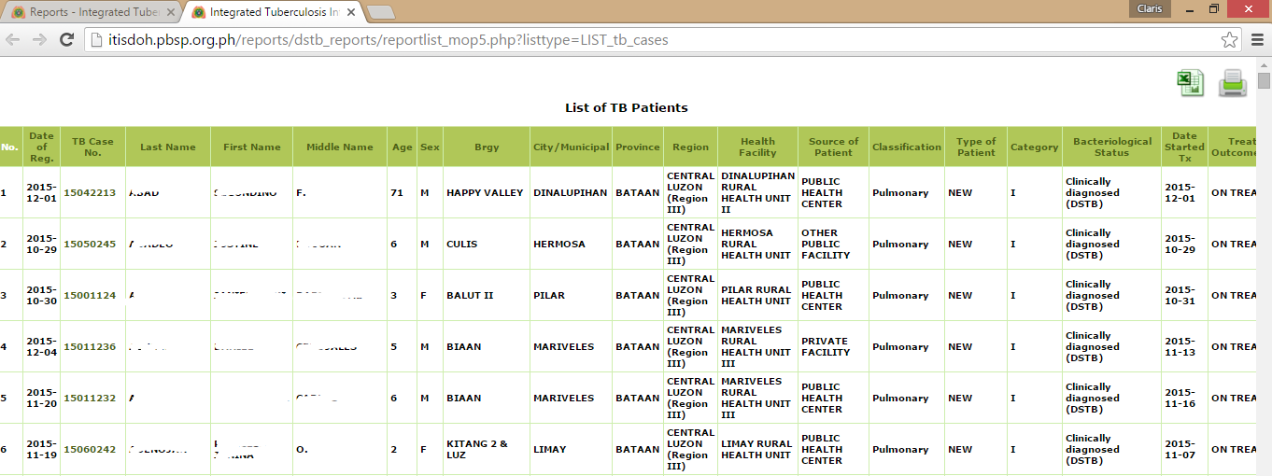
Notes:
If there are double entries, ask the KMITS representative for assistance in deleting the duplicate case.

Slide 18
Record Findings in DQC Form A
IF with Double entries:
case no./name
2015-34
2016-30
2015-28
2016- 15

Slide 19
Checking at the Facility Level
STEP 2:
In the generated report, click the total number cases to display the patient list.
‘Click to display patient list’
28

Slide 21
Checking at the Facility Level
STEP 2:
Compare the patient list and TB register. Note if there are discrepancies.
If with discrepancies: Update ITIS cases (encode missing cases, update cases with incomplete details) until discrepancies noted are reconciled.

Slide 22
New Tab
To update
a Case
‘Reports Tab’
Sort the Case Number if needed
Open the case to be updated

Slide 23
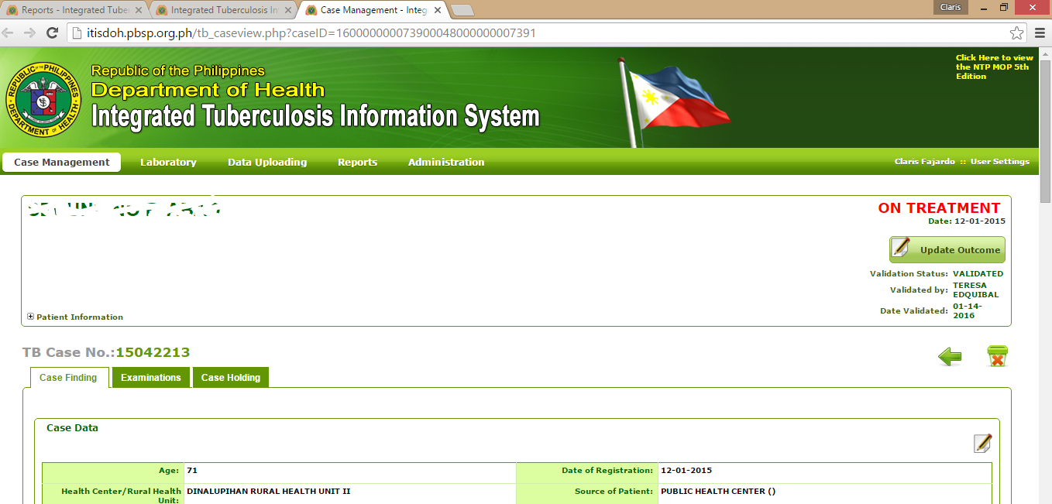
New Tab

Slide 24
DO the above procedures for the 2 periods (both current and cohort)
  (insert period of current report, e.g., 2016 Q1)
  (insert period of cohort report, e.g., 2015 Q1)

Slide 25
CHECK also completeness of paper-based records
  Presumptive TB Masterlsit
  TB Laboratory Register
Notes:
This can be an optional procedure depending on DOHRO and/or PHO

Slide 26
Step 2: Assessing Data Completeness
Check the following (Form 1. Presumptive TB Masterlist)
  For the period , are the entries for each row/patient in the NTP laboratory register complete? Yes or No?
    Count the number of entries that are complete
    Count the number of entries that are incomplete
    Indicate the numbers in the DQC form
    Make a conclusion: out of 20 entries/patients, 15 (75%) had complete entries while 5 (25%) had incomplete entries. The most common missing data are ___________.
Notes:
The first exercise is on data completeness.
For the presumptive TB masterlist, the “assessor” should check entries for each patient registered. Each patient will be considered as one unit.
For completeness, just check if all the applicable fields have information supplied.
The number of patients to be checked will depend on the patient load for the quarter and the time available. If it is a quarterly DQC and there is enough time, all patients should be reviewed.
If time is limited, agree with the PHO on the maximum number of patients to be assessed. For example, 10 patients to be reviewed for completeness.

Slide 27
Notes:
This is a copy of the presumptive TB masterlist. All applicable fields should be complete.
If a patient has complete entries, count under Complete in the DQC form. If a patient has incomplete entries, count under Incomplete in the DQC form.

Slide 28
Step 2: Assessing Data Completeness
Check the following (Form 3. NTP Laboratory Register):
  For the period, are the entries for each row/patient in the NTP laboratory register complete? Yes or No?
    Count the number of entries that are complete
    Count the number of entries that are incomplete
    Indicate the numbers in the DQC form
    Make a conclusion: example - out of 20 entries/patients, 15 (75%) had complete entries while 5 (25%) had incomplete entries. The most common missing data are ___________.
Notes:
Checking of laboratory register will follow the same procedure as that in the presumptive TB masterlist.
The number of patients to be checked will depend on the patient load for the quarter and the time available. If it is a quarterly DQC and there is enough time, all patients should be reviewed.
If time is limited, agree with the PHO on the maximum number of patients to be assessed. For example, 10 patients to be reviewed for completeness.

Slide 29
Notes:
This is the Laboratory register. Check for completeness just like in the Presumptive TB masterlist.
Each patient is considered one unit.

Slide 30
Step 2: Assessing Data Completeness (DQC Form A)
120
20
No outcome of referral
indicated in remarks
89
10
No signature of
Microscopist
Notes:
This is the DQC Form to be used in this exercise.

Slide 31
Stop here until you finish check of completeness…

Slide 32
DQC Procedures
ACCURACY OF DATA

Slide 33
Definition
Accuracy - data/information provided in the recording and reporting forms are correct and conform to the MOP protocols and guidelines
If you have less than 15 patients for the quarter, check ALL treatment cards (TB Register). If you have more than 15 patients, randomly select just 15 patients.
Notes:
For timeliness—discuss when to “lock” system for generating quarterly reports (e.g., lock within 2nd week of the first month)

Slide 35
Assessing Data Accuracy (TB Classification)
Pulmonary or Extrapulmonary
  If classified as EPTB:
    Check result of Xpert MTB/Rif from specimen other than sputum
    Check results of other diagnostic exams (biopsy, other imaging studies, etc.)
    (note: EPTB can also be diagnosed clinically if no access to other diagnostic exams)
  If classified as pulmonary TB, check:
    DSSM or sputum Xpert MTB/Rif (or sputum culture)
    Chest X-ray result
    3/5 criteria for diagnosing PTB in children
    (note: PTB can be diagnosed in HIV positive even with negative DSSM and CxR)
  If patient has both PTB and EPTB, classified as PTB except EPTB of CNS, bones, joints
Notes:
Based on the case definitions, check accuracy of classification by anatomic site based on the above criteria.
Notes:
The general guideline here is to find the basis for classifying patient as PTB or EPTB.
Hence, if classified as EPTB, identify the basis by checking Xpert for extrapulmonary specimen, or by checking other diagnostic exams. However, note that EPTB may be diagnosed by clinical grounds alone, especially in far-flung areas. In this case, there might not be any evidence documented in the treatment card. Just make sure it is not a case of pulmonary TB (i.e., positive DSSM or positive Chest Xray).
If PTB, determine basis for PTB---either DSSM or chest Xray or 3/5 criteria for children.
Note the guideline if patient has both PTB and EPTB.

Slide 36
Check other exam for EPTB
Check CxR for PTB
Verify the classification of PTB or EPTB
Check Xpert MTB/Rif
Check DSSM for PTB
Notes:
This is an illustration of what to check to assess accuracy of classification. Arrows in this treatment card illustrate the items shown in the previous slide.
The red arrow indicates what is being checked (i.e., classification of TB) and the yellow arrows indicate the information to be checked or validated as basis for the classification.

Slide 37
Household contact with TB
TST
CxR
Verify the classification of PTB or EPTB
(3/5 criteria for children with pulmonary symptoms)
Other exams
Clinical symptoms
Notes:
This is an illustration of what to check to assess accuracy of classification for children using the 3/5 diagnostic criteria. This is applicable for children with pulmonary TB symptoms.
The red arrow indicates what is being checked (i.e., classification of TB) and the yellow arrows indicate the information to be checked or validated as basis for the classification. The five arrows here represent the five criterion for diagnosing TB in children.
Exposure to a known TB case may be obtained by contact tracing or if patient was initially brought in for contact screening
For patient to be labelled as “positive for clinical symptoms”, he/she must fulfill 3/6 clinical criterion:
Unexplained fever, two weeks
Unexplained cough/wheezing, two weeks
Unimproved general well-being (fatigue, reduced playfulness, lethargy)
Poor appetite (weight loss, weight faltering, failure to gain weight)
Failure to respond to two weeks of appropriate antibiotic therapy (not reflected here but may be indicated in Remarks column at the back of the form)
Failure to return to previous state of health two weeks after a viral infection such as measles (not reflected here but may be indicated in the Remarks column at the back of the form)

Slide 38
Assessing Data Accuracy (TB Classification)
Bacteriologically confirmed or clinically diagnosed
Bacteriologically confirmed if with positive:
  DSSM results
  Xpert result (if available)
  TB culture (if available)
Notes:
Based on the case definitions, check accuracy of classification by bacteriologic status.
This is easier and more straightforward. Confirm all bacteriologically diagnosed cases by a positve DSSM, Xpert or culture result. If none of these are positive, the case may not be labelled bacteriologically confirmed.

Slide 39
Check Xpert results
Verify the classification of bacteriologic status
Check DSSM
Notes:
This is an illustration of what to check to assess accuracy of classification by bacteriologic status.
The red arrow indicates what is being checked (i.e., bacteriologic status) and the yellow arrows indicate the information to be checked (i.e., DSSM, Xpert or culture result/s).

Slide 40
Assessing Data Accuracy (Registration Group)
Cross-check the registration group with:
  History of previous treatment
  Treatment regimen given
Notes:
Based on the case definitions, check accuracy of the registration group.
Based on history of treatment:
New cases should have no history of treatment or with history of treatment but less than one month.
All retreatment cases (relapse, TALF, TAF, PTOU) should have an indicated treatment history.
“Others” may or may not have a treatment history (e.g., previous treatment history unknown) but does not fit into any of the registration groups. Ideally, this should be explained in the Remarks section on the back page of the treatment card.
Correlate also the registration group with the treatment regimen given.
New cases should receive Category I or Ia.
Retreatment and Other cases should receive Category II or Category Iia.

Slide 41
Check history of previous treatment
Check treatment regimen
Verify the registration group
Notes:
This is an illustration of what to check to assess accuracy of registration group.
The red arrow indicates what is being checked (i.e., registration group) and the yellow arrows indicate the information to be checked (i.e., history of treatment and correlation with treatment regimen given).

Slide 42
Assessing Data Accuracy (Treatment Outcome)
Cross-check the treatment outcome with:
  Classification of bacteriologic status ( a clinically diagnosed case cannot be assigned an outcome of cured)
  Follow-up DSSM results
  Completion of drug intake (completed intensive and continuation phase)
  Resolution of symptoms
Notes:
This covers cases registered one year ago OR at least six months ago, with an assigned outcome.
Notes:
A clinically diagnosed TB case that is given an outcome of cured should be noted as inaccurate outcome.
A cured patients should be: 1) bacteriologically confirmed at start of treatment, 2) completed entire course of treatment, 3) with negative DSSM in last month of treatment and one other follow-up during the maintenance phase.
For children (and may be applied to adults who are clinically diagnosed), check also the resolution of symptoms at the bottom half of the treatment card.

Slide 43
Check bacteriologic status at start Tx
Check DSSM follow-up results
Verify the treatment outcome
Check resolution of symptoms
Notes:
This is an illustration of what to check to assess accuracy of treatment outcome.
The red arrow indicates what is being checked (i.e., outcome of treatment) and the yellow arrows indicate the information to be checked (i.e., bacteriologic status at start of treatment, DSSM follow-up, resolution of symptoms and completion of drug intake—next slide).

Slide 44
Check drug intake if completed intensive and maintenance phase
Notes:
This is an illustration of what to check to assess accuracy of treatment outcome.
The yellow arrows indicate the information to be checked (i.e., completion of drug intake).

Slide 45
Check 1stQ 2016
26
0
26
2
2 patients with history of
treatment but treated as NEW
5 patients completed treatment
but incomplete record of drug intake
Check 1stQ 2015
30
5

Slide 46
Assessing Data Accuracy (DRTB Screening)
(1) From the DSTB Register, check if the following have been referred for DRTB screening:
  all retreatment cases (Relapse, TALF, TAF, PTOU, Other)
  All non-converters (still smear positive at 3 months)
  All with “Failed” Treatment Outcome
Check Xpert result recorded in the register. If none, cross-check in the Presumptive TB masterlist if with Xpert result.
(2) From the Presumptive TB Masterlist, count how many were identified as presumptive DRTB-- Check if with Xpert result
Notes:
The second part of accuracy assessment concerns identification of DRTB suspects and determination if patients are screened for DRTB screening.
This can be checked from two data sources:
Check the DRTB register if the following were screened for DRTB:
all registered Category 2 patients (retreatment)
All non-converters, or those with positive DSSM follow-up at three months
All with treatment outcome of failed
Check the Presumptive TB masterlist if all presumptive DRTB identified were screened for DRTB
IMPORTANT NOTE: The definition of successfully screened for DRTB is that patient must have a documented Xpert result which is recorded in the DSTB register or in the presumptive masterlist. If there is a note in the Remarks column that patient was referred but there is no Xpert result, this does not count as successful referral. Indicate in the remarks of the DQC form if this is the case to signify need to strengthen feedback mechanisms between DOTS facilities and Xpert sites/PMDT TCs.
(More notes next slide)

Slide 47
Assessing Data Accuracy (DRTB Screening)
(1) From the DSTB Register, check if the following have been referred for DRTB screening:
  all retreatment cases (Relapse, TALF, TAF, PTOU, Other)
  All non-converters (still smear positive at 3 months)
  All with “Failed” Treatment Outcome
Check Xpert result recorded in the register. If none, cross-check in the Presumptive TB masterlist if with Xpert result.
(2) From the Presumptive TB Masterlist, count how many were identified as presumptive DRTB-- Check if with Xpert result
Notes:
FROM THE DSTB REGISTER:
Ask participants to count the following:
all retreatment (i.e., relapse, TALF, TAF, PTOU, Other) cases registered for the period (from Column 11)
All cases with positive sputum follow-up at 3rd month of treatment (from column 14, 3rd month)
All cases with “failed” treatment outcome (from Column 15)
For each patient above, determine if referral for DRTB screening was done.
Check if all retreatment cases (Cat 2) have an Xpert result recorded in the TB register. An Xpert result showing MTB not detected (meaning it was diagnosed clinically) or MTB detected, rifampicin susceptible means the patient was screened for DRTB before treatment.
If there is no Xpert result nor note in the Remarks column, look for the name of the patient in the Presumptive TB masterlist and check also if there is an Xpert result recorded.
FROM THE PRESUMPTIVE TB MASTERLIST:
Ask them to count all identified Presumptive DRTB by looking at Column 12.
For each patient identified as DRTB, determine if referral for DRTB screening was done.
Check if there is an Xpert result recorded in Column 11
.

Slide 48
Count all retreatment cases
Count non-converters
Check if retreatment and non-converters have an Xpert result
Notes:
This is the DSTB Register.
Count retreatment from the column on registration group. Determine how many of these retreatment cases were referred for DRTB screening by looking at the Remarks column.
(Note: If patient is a retreatment and trans-in case, referral for DRTB screening should still be documented in the Remarks column even if done by the referring facility. But this patient will not appear in the presumptive TB masterlist. In case it is not indicated, you may count him/her as not referred, and for verification later with your partner RHU--owner of the register).

Slide 49
Count “failed” treatment outcome
Check if Failed cases have an Xpert result
Notes:
This is the DS TB Register.
Count retreatment from the column on registration group. Determine how many of these retreatment cases were referred for DRTB screening by looking at the Remarks column.
(Note: If the patient is a retreatment and trans-in case, referral for DRTB screening should still be documented in the Remarks column even if done by the referring facility. But this patient will not appear in the presumptive TB masterlist. In case it is not indicated, you may count him/her as not referred, and for verification later with your partner RHU--owner of the register).

Slide 50
Check 1stQ 2016
26
0
26
2
2 patients with history of
treatment but treated as NEW
5 patients completed treatment
but incomplete record of drug intake
Check 1stQ 2015
30
5
Check 1stQ 2016
5
5
1
0
Check 1stQ 2015
2
0

Slide 51
Count presumptive DRTB
Cross-check name presumptive DRTB from TB register
Check if there is an Xpert result
Notes:
If referral for DRTB screening is not documented in the Remarks column of the TB register, cross check in the Presumptive TB masterlist.
Look for the name of the retreatment case in the Presumptive TB masterlist. If located, look at the column on “Presumptive DRTB” and also in the Remarks column to determine if patient was identified as DRTB and referred.
For presumptive DRTB not registered into treatment, check if Xpert result is available or if referral is indicated in the Remarks column.

Slide 52
Step 2:
Assessing
Data Accuracy
Notes:
This is an example of the accomplished DQC Form B.
Emphasize the use of numbers instead of mere checking.
Conclusions at the bottom should summarize the findings.

Slide 53
Stop here until you finish check of accuracy…

Slide 54
DQC Procedures
CONSISTENCY OF DATA

Slide 55
Definition
Consistency - data and information from one NTP record (e.g., paper-based DSTB register) to another is similar or figures from the NTP reports should be exact and the same from the source when calculated (checking for encoding errors)
Notes:
For timeliness—discuss when to “lock” system for generating quarterly reports (e.g., lock within 2nd week of first month)

Slide 56
Procedures for Checking Consistency
  Manually count (just totals) to prepare a manual quarterly report
    Reports to check: Reports 3a and 5a
  Compare the manual report with the ITIS-generated report
  If discrepancies exist, compare ITIS line list with DSTB register to locate and correct discrepancy
    Create a filtered line-list (e.g., patient list of new bacteriologically confirmed positive TB) to facilitate checking
Notes:
Emphasize that participants WILL NOT reconstruct manually the ENTIRE QUARTERLY REPORT.
Only the totals will be counted as a final consistency check before submitting the validated report.

Slide 57
There were 5 cases with no recorded
treatment outcome (not MDRTB)

Slide 58
Bacteriologically Confirmed NEW
Bacteriologically Confirmed RELAPSE
Bacteriologically Confirmed Re-Tx
(TALF, TAF, PTOU, Other)
Clinically Diagnosed NEW
Clinically Diagnosed Relapse
Clinically Diagnosed Re-Tx
(TALF, TAF, PTOU, Other)
(Insert period
being reviewed)
Notes:
Participants will ONLY COUNT THESE TOTALS, NOT FOR THE ENTIRE REPORT.

Slide 59
Bacteriologically Confirmed NEW
  Cured
  Treatment Completed
Bacteriologically Confirmed RELAPSE
  Cured
  Treatment Completed
Clinically Diagnosed NEW
Treatment Completed
Clinically Diagnosed Relapse
Treatment Completed
(Insert period
being reviewed)
Notes:
Participants will ONLY COUNT THESE TOTALS, NOT THE ENTIRE REPORT.

Slide 60
Checking at the Facility Level
Generate the ITIS
Report.
Check if the totals match the manual count done.
You may click on
these numbers
to generate the
specific patient
list.

Slide 61
IF there are discrepancies, you may click on any number in the quarterly report to generate the specific patient list (e.g., patient list of new bacteriologically confirmed TB cases). Compare with the DSTB register to determine cause of discrepancy.

Slide 62
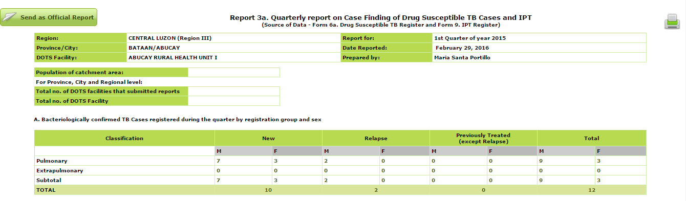
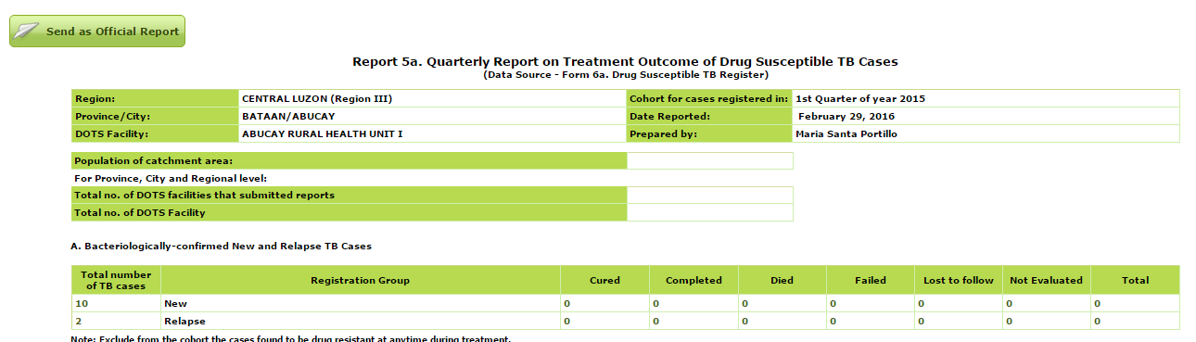
Click the ‘Send as Official Report’ for Report 3A
Once final consistency
check is satisfactory,
resend the validated
report to the PHO
Click the ‘Send as Official Report’ for Report 5A

Slide 63
End of DQC for completeness, accuracy, and consistency

Slide 64
DQC Procedures
TIMELINESS OF DATA

Slide 65
Procedures for Checking Timeliness
Patient list can be converted to an excel file
Participants may be taught how to use the excel spreadsheet (using the date started treatment as reference) to analyze data on the following:
  Updating of sputum follow-up
  Timely assignment of treatment outcomes
  Turnaround time (at least the lag time between baseline sputum result and date start treatment)

Slide 66
Generate patient list of (insert current period being reviewed)

Slide 67
Checking at the Facility Level
STEP 1:
Generate the specific report needed (e.g., Report 3a)

Slide 68
Checking at the Facility Level
In the generated report, click the total number cases to display the patient list
28

Slide 69
Convert to
excel file.

Slide 70
Computing Turnaround Time
1) Convert to Excel file the following variables and sort according to DSSM result
TB Case No. | Name of Patient | DATE START TREATMENT | DATE BASELINE DSSM | Result (baseline DSSM)
161010002 | AB | 1/9/2016 | 1/2/2016 | 0
161010005 | BB | 1/14/2016 | 1/5/2016 | 0
161010007 | CA | 1/20/2016 | 1/11/2016 | 0
161010008 | CB | 1/22/2016 | 1/10/2016 | 0
161010003 | AC | 1/10/2016 | 1/8/2016 | 1+
161010004 | BA | 1/10/2016 | 1/8/2016 | 1+
161010009 | CC | 1/25/2016 | 1/23/2016 | 1+
161010010 | DA | 1/27/2016 | 1/24/2016 | 1+
161010001 | AA | 1/5/2016 | 1/2/2016 | 2+
161010006 | BC | 1/15/2016 | 1/13/2016 | 2+

Slide 71
Computing Turnaround Time
2) Add additional column for TAT and insert formula
1 | A | B | C | D | E | F
2 | TB Case No. | Name of Patient | DATE START TREATMENT | DATE BASELINE DSSM | Result (baseline DSSM) | TAT
3 | 161010002 | AB | 1/9/2016 | 1/2/2016 | 0
4 | 161010005 | BB | 1/14/2016 | 1/5/2016 | 0
5 | 161010007 | CA | 1/20/2016 | 1/11/2016 | 0
6 | 161010008 | CB | 1/22/2016 | 1/10/2016 | 0
7 | 161010003 | AC | 1/10/2016 | 1/8/2016 | 1+
8 | 161010004 | BA | 1/10/2016 | 1/8/2016 | 1+
9 | 161010009 | CC | 1/25/2016 | 1/23/2016 | 1+
10 | 161010010 | DA | 1/27/2016 | 1/24/2016 | 1+
11 | 161010001 | AA | 1/5/2016 | 1/2/2016 | 2+
12 | 161010006 | BC | 1/15/2016 | 1/13/2016 | 2+
=C3-D3

Slide 72
Computing Turnaround Time
3) Apply formula to all patients
1 | A | B | C | D | E | F
2 | TB Case No. | Name of Patient | DATE START TREATMENT | DATE BASELINE DSSM | Result (baseline DSSM) | TAT
3 | 161010002 | AB | 1/9/2016 | 1/2/2016 | 0 | 7
4 | 161010005 | BB | 1/14/2016 | 1/5/2016 | 0 | 9
5 | 161010007 | CA | 1/20/2016 | 1/11/2016 | 0 | 9
6 | 161010008 | CB | 1/22/2016 | 1/10/2016 | 0 | 12
7 | 161010003 | AC | 1/10/2016 | 1/8/2016 | 1+ | 2
8 | 161010004 | BA | 1/10/2016 | 1/8/2016 | 1+ | 2
9 | 161010009 | CC | 1/25/2016 | 1/23/2016 | 1+ | 2
10 | 161010010 | DA | 1/27/2016 | 1/24/2016 | 1+ | 3
11 | 161010001 | AA | 1/5/2016 | 1/2/2016 | 2+ | 3
12 | 161010006 | BC | 1/15/2016 | 1/13/2016 | 2+ | 2
=C3-D3

Slide 73
Computing Turnaround Time: 4) Get average for BC and CD
1 | A | B | C | D | E | F
2 | TB Case No. | Name of Patient | DATE START TREATMENT | DATE BASELINE DSSM | Result (baseline DSSM) | TAT
3 | 161010002 | AB | 1/9/2016 | 1/2/2016 | 0 | 7
4 | 161010005 | BB | 1/14/2016 | 1/5/2016 | 0 | 9
5 | 161010007 | CA | 1/20/2016 | 1/11/2016 | 0 | 9
6 | 161010008 | CB | 1/22/2016 | 1/10/2016 | 0 | 12
7 | 161010003 | AC | 1/10/2016 | 1/8/2016 | 1+ | 2
8 | 161010004 | BA | 1/10/2016 | 1/8/2016 | 1+ | 2
9 | 161010009 | CC | 1/25/2016 | 1/23/2016 | 1+ | 2
10 | 161010010 | DA | 1/27/2016 | 1/24/2016 | 1+ | 3
11 | 161010001 | AA | 1/5/2016 | 1/2/2016 | 2+ | 3
12 | 161010006 | BC | 1/15/2016 | 1/13/2016 | 2+ | 2
=AVERAGE(F3:F6)
=AVERAGE(F7:F12)

Slide 74
Computing Turnaround Time
1 | A | B | C | D | E | F
2 | TB Case No. | Name of Patient | DATE START TREATMENT | DATE BASELINE DSSM | Result (baseline DSSM) | TAT
3 | 161010002 | AB | 1/9/2016 | 1/2/2016 | 0 | 7
4 | 161010005 | BB | 1/14/2016 | 1/5/2016 | 0 | 9
5 | 161010007 | CA | 1/20/2016 | 1/11/2016 | 0 | 9
6 | 161010008 | CB | 1/22/2016 | 1/10/2016 | 0 | 12 | 9
7 | 161010003 | AC | 1/10/2016 | 1/8/2016 | 1+ | 2
8 | 161010004 | BA | 1/10/2016 | 1/8/2016 | 1+ | 2
9 | 161010009 | CC | 1/25/2016 | 1/23/2016 | 1+ | 2
10 | 161010010 | DA | 1/27/2016 | 1/24/2016 | 1+ | 3
11 | 161010001 | AA | 1/5/2016 | 1/2/2016 | 2+ | 3
12 | 161010006 | BC | 1/15/2016 | 1/13/2016 | 2+ | 2 | 2

Slide 75
9 for CD
2 for BC

Slide 76
End of Day 1
Please make sure to submit your latest ITIS data to the PHO
Notes:
TO facilitate submission, the PHO/DOHRO is advised to flash in the presentation screen the ITIS tally of reports submitted per RHU (per facility report). This will show which facilities have already submitted updated and validated reports.

Slide 77
Day 2: Summarizing DQC Findings and Computing NTP Indicators

Slide 78
Summarize DQC Findings (From the DQC Forms)

Slide 79
Summarize DQC Findings (examples)
only 23/30 cases encoded
5/35 cases did not have Tx outcome encoded
35/35 of cases had accurate classification (P/EPTB; BC/CD)
2/35 cases with inaccurate reg group (NEW even is with history of treatment)
3/30 cases had completed outcome but incomplete record of intake
Only 2/5 retreatment case with Xpert result; 0/1 non-converter referred for Xpert; 0/2 failed TB cases referred for Xpert
ITIS quarterly reports consistent with no discrepancy
TAT was 9 days for CDTB and 3 days for BCTB

Slide 80
Discussion of TB GIS

Slide 81
Objective 3: Assist LGUs in using ITIS-generated information for program decisions and planning
Computation of routine NTP program indicators for each LGU
  Indicators are automatically computed through TB GIS dashboard
  Orientation on use of dashboard can be included in initial workshop
Analysis of NTP indicators and review of plans according to current accomplishments

Slide 82
Compute and Analyze NTP Indicators (2015)

Slide 83
Plenary Discussion
DQC Findings and NTP Indicators

Slide 84
Discussion with PHO
Generation of Provincewide ITIS Report

Slide 85
Consolidation of Reports at the PHO and CHO Levels
The PHO/CHO will consolidate the validated data from each individual LGU/DOTS facility
Routine indicators will also be monitored and analyzed

Slide 86
The following slides are reference slides and are “hidden”

Slide 87

Aggregate Report

Slide 88

Aggregate Report
An ITIS-generated report to be used by the ROs, PHOs and CHOs to consolidate and analyze facility-based reports
Transfers facility-based data into “FLAT TABLES” for easy analysis
Integrated Tuberculosis Information System - Knowledge Management and Information Technology Services

Slide 89
NTP
RO
CHO /
PHO
Facility
Level

Slide 90
CHO /
PHO
  Generate Aggregate Report for cross validation.
  If OFFLINE sites, extract facility-based reports. Encode aggregate data (from non-implementing ITIS site/s) to complete the provincial aggregate report
  Notify RO that aggregate report is completed.
  **Extract aggregate report to Excel (Flat Table) for analysis
Facility
Level
  Generate Quarterly Report.
  Check for accuracy, completeness and consistency.
  Send the report as “OFFICIAL”.

Slide 91
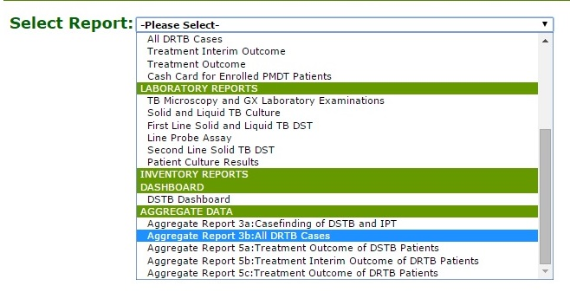
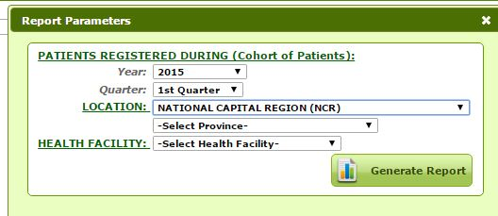
STEP 1: PHO/ CHO will generate the aggregate data
PHO/CHO sets the report parameters for the aggregate data.
Integrated Tuberculosis Information System - Knowledge Management and Information Technology Services

Slide 92
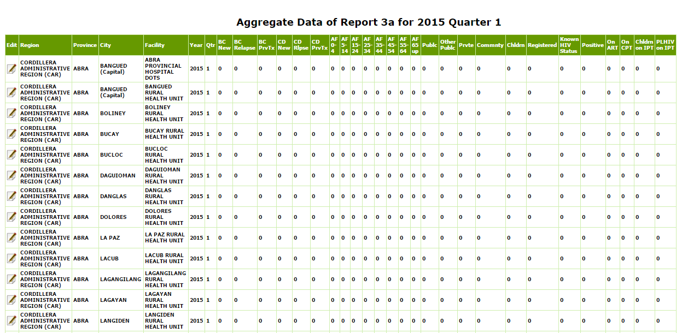
STEP 2: PHO/ CHO will check the aggregate data
The list of facilities per catchment area is viewed along with # of cases reported
Integrated Tuberculosis Information System - Knowledge Management and Information Technology Services

Slide 93
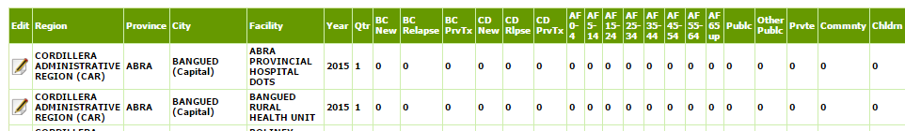
STEP 3: PHO/ CHO updates the aggregate data for non-implementing ITIS site
Click the paper and pencil icon to update the record.
Integrated Tuberculosis Information System - Knowledge Management and Information Technology Services

Slide 94
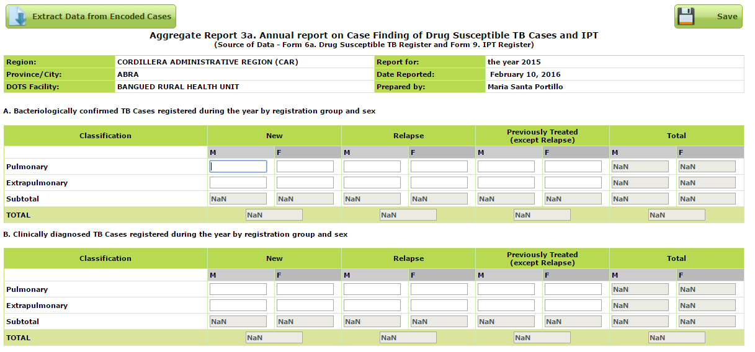
Integrated Tuberculosis Information System - Knowledge Management and Information Technology Services

Slide 95
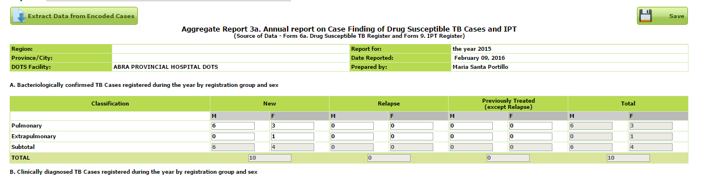
If the facility is offline, CHO/PHO extracts the data
Click the ‘extract data from encoded cases’ to fill-out fields
Click Save
Integrated Tuberculosis Information System - Knowledge Management and Information Technology Services

Slide 96
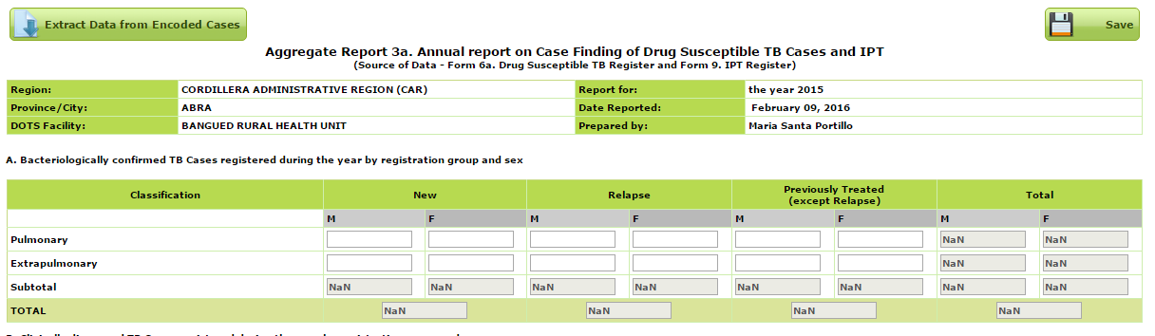
If the facility is not implementing ITIS, encode the data
Enter the aggregate / numbers to the corresponding fields. The ‘totals’ are auto-compute.
Click Save
Integrated Tuberculosis Information System - Knowledge Management and Information Technology Services

Slide 97
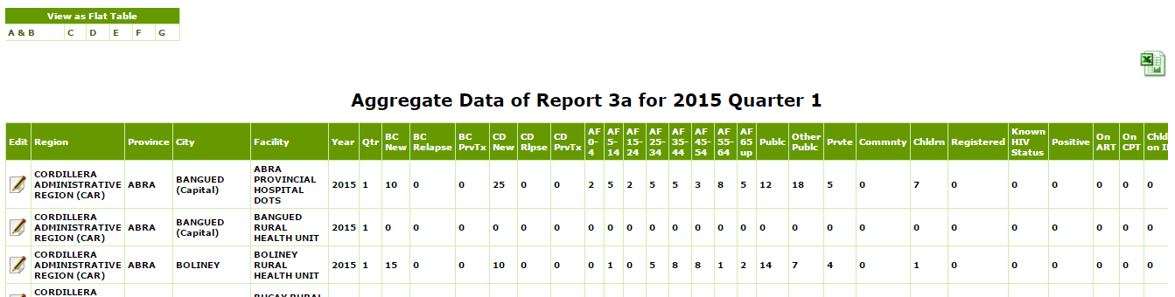
STEP 4: Once data is complete and validated, PHO/CHO sends the data to RO as final report
Integrated Tuberculosis Information System - Knowledge Management and Information Technology Services

Slide 98
ANALYSIS: NTP/ RO/ CHO/ PHO downloads the specific flat tables for analysis
Click the flat table needed
Integrated Tuberculosis Information System - Knowledge Management and Information Technology Services

Slide 99
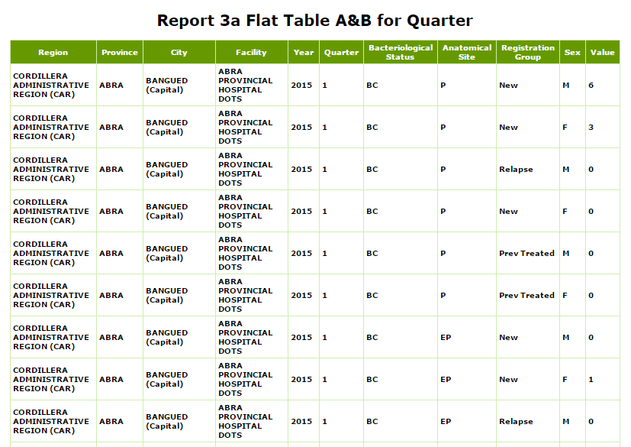
Integrated Tuberculosis Information System - Knowledge Management and Information Technology Services

Slide 100
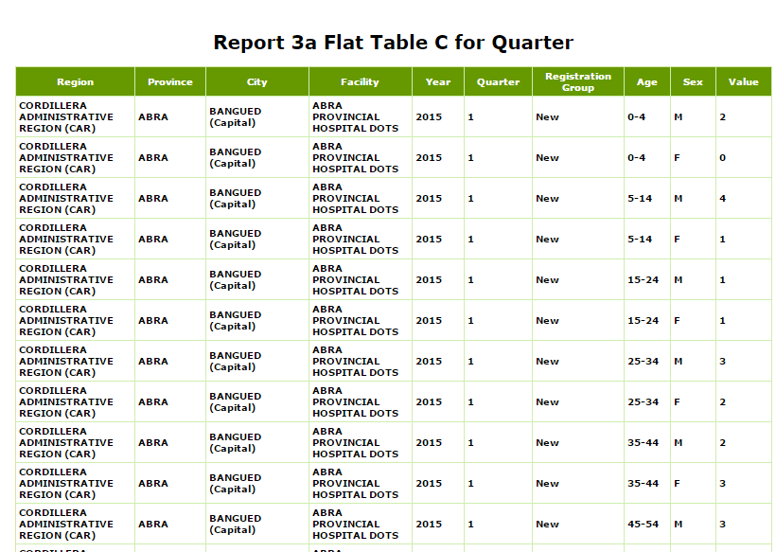
Integrated Tuberculosis Information System - Knowledge Management and Information Technology Services

Slide 101
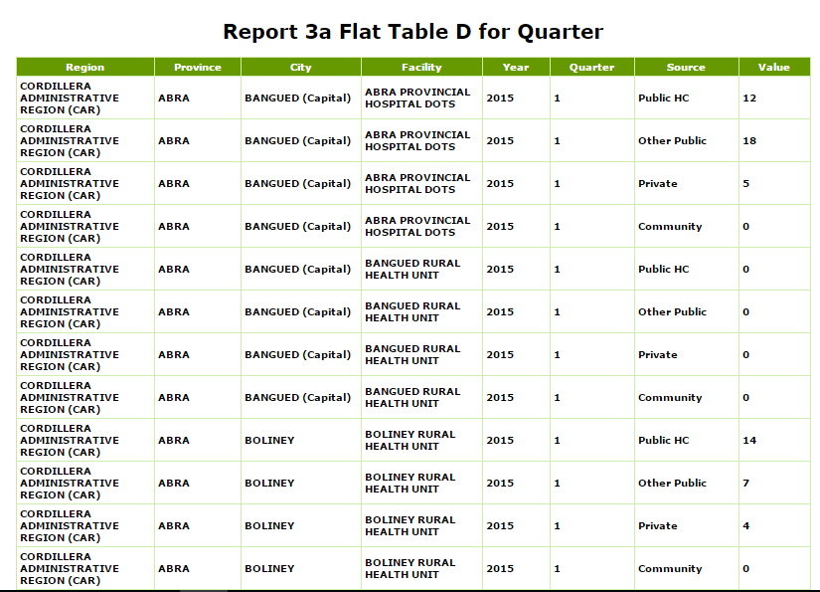
Integrated Tuberculosis Information System - Knowledge Management and Information Technology Services

Slide 102
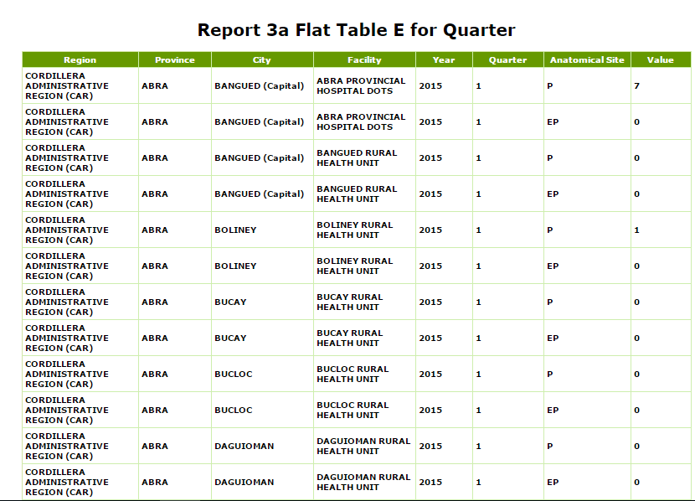
Integrated Tuberculosis Information System - Knowledge Management and Information Technology Services

Slide 103
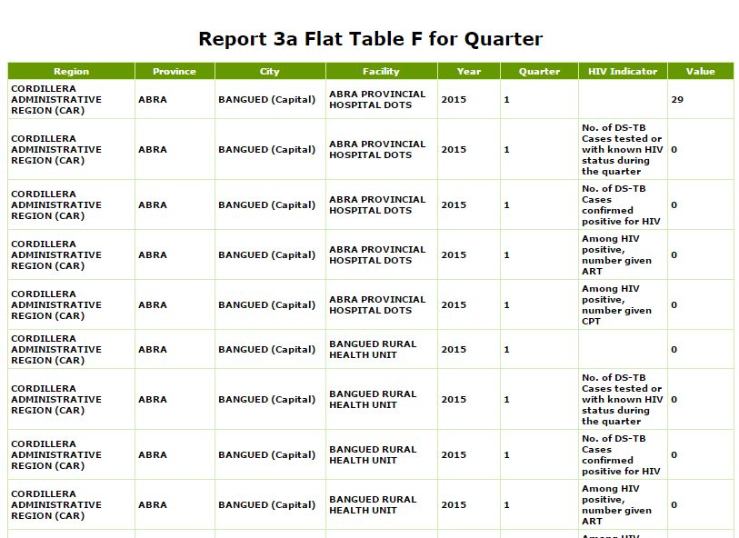
Integrated Tuberculosis Information System - Knowledge Management and Information Technology Services

Slide 104
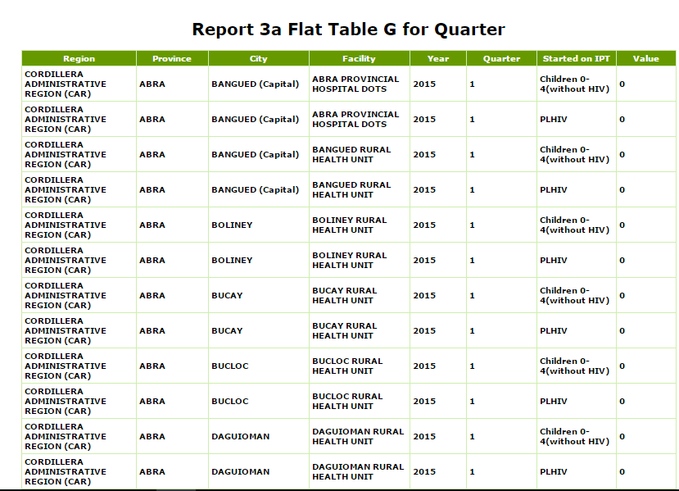
Integrated Tuberculosis Information System - Knowledge Management and Information Technology Services

